Slide 1
ACT/SAT
Countryside Library, 2/4/2024
Eliot Schrefer
While you’re waiting:
A train leaves Smallville at 8am, going 120 mph. At 8:40am, a second train leaves along the same track, going the same direction at 160 mph. At what time will the trains meet?
a) 9am d) 10:40am
b) 9:40am e) 11am
c) 10am

Slide 2


Slide 3


Slide 4
“I Stand for Nothing”
1901: Scholastic Achievement Test
1941: Scholastic Aptitude Test
1990: Scholastic Assessment Test
1994: S A T

Slide 5
ACT Logistics
Established in 1959 to compete with the SAT
Close to same number of test takers (1.4 million a year, compared to SAT’s 1.7 million)

Slide 6
Major Differences--Now Minor Differences
Type of student who takes it.
Timing versus reasoning.
No significant regional differences any longer.

Slide 7
What the ACT is made of
English: 1-36 score
  45 minutes, 75 questions (divided into 5 passages).
Math: 1-36 score
  60 minutes, 60 questions.
Reading: 1-36 score
  35 minutes, 40 questions (divided into 4 passages).
Science: 1-36 score
  35 minutes, 40 questions (divided into 7 passages).
(Overall score is average of 4 sub-sections, rounded up, with an average around 19-20)

Slide 8
What the SAT is made of
ADAPTIVE COMPUTER-BASED EXAM
Evidence-Based Reading & Writing: 200-800 score
  One 64-minute section, broken into two modules
Math: 200-800 score
  One 70-minute section, broken into two modules
Both scores are reported individually, for a total score between 400-1600, with an average of about 1000.

Slide 9




Slide 10
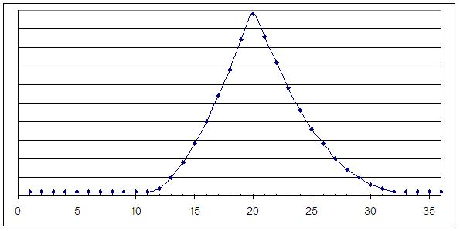
Overall tips
These are tests of long-term focus above all else.
  Practice is essential. (My students take 10-15 practice tests)
You should put an answer down for each question.
Average score corresponds to getting roughly half the questions right.
  Don’t be a perfectionist.

Slide 11
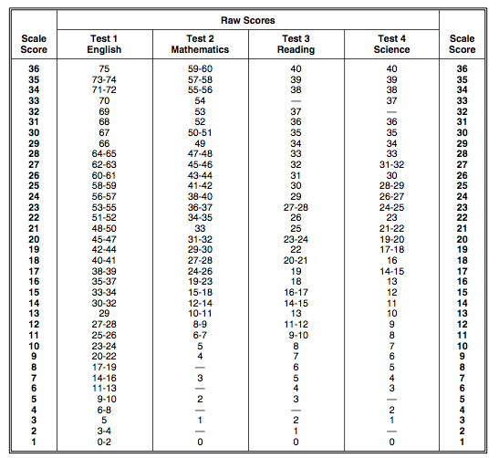

Slide 12
Overall tips
Keep an eye out for the words “NOT” or “EXCEPT”
You have to get a handle on your timing.
Be sure to answer the question being asked.

Slide 13
Prep Schedule and Test Dates
ACT: September, October, December, February, April, June, July.
SAT: August, October, November, December, January, March, May, June.
Register early—at least a month before.
  (Though walk-ins usually work)

Slide 14
The English (Grammar) Section
Find a pace that will allow you to finish
Most reliable score increase.

Slide 15
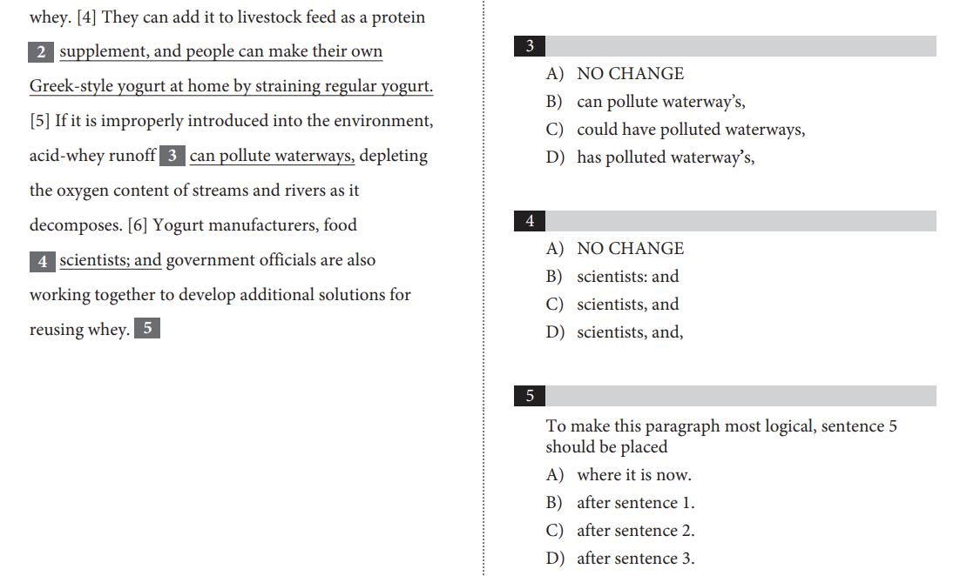

Slide 16
Grammar
The shortest one is correct 50% of the time.
If a question asks about verb tense or transition words (“therefore” vs. “however”), read the whole paragraph, not just the surrounding line.
In a question asking you to choose an answer that does something specific (i.e. “Which of the following additions would provide a concrete example”) worry about satisfying that condition more than which answer choice has the best grammar/style.

Slide 17
Commas
Know where to put the commas in the following:
  Unlike all the other kids Becky has to wear a retainer.
  I have been to Florida North Carolina and Georgia.
  Luke of all the Smith children is the tallest.

Slide 18
“The audience of parents, teachers, and students are getting ready to applaud.”

Slide 19
“Crossing the street, a car almost hit me.”

Slide 20
Math
[ACT only]: This time it’s NOT crucial that you finish the section, as the questions go from easy to hard.
  Still put an answer down for everything.
Brush up on:
  SohCahToa
  Lines and slopes (y=mx+b, rise/run)

Slide 21
3 Keys to Math Success
1. Underline Key Words
2. Write all Steps
3. Re-read the Question before Bubbling in the Answer

Slide 22
Plugging in Numbers
[Do this is there are variables in the answer choices.]
1. Assign a value to the variable. Write it down. (ex. X=5)
2. Work through the problem using your chosen value.
3. Plug the value from Step 1 into the answer choices and see which matches.

Slide 23
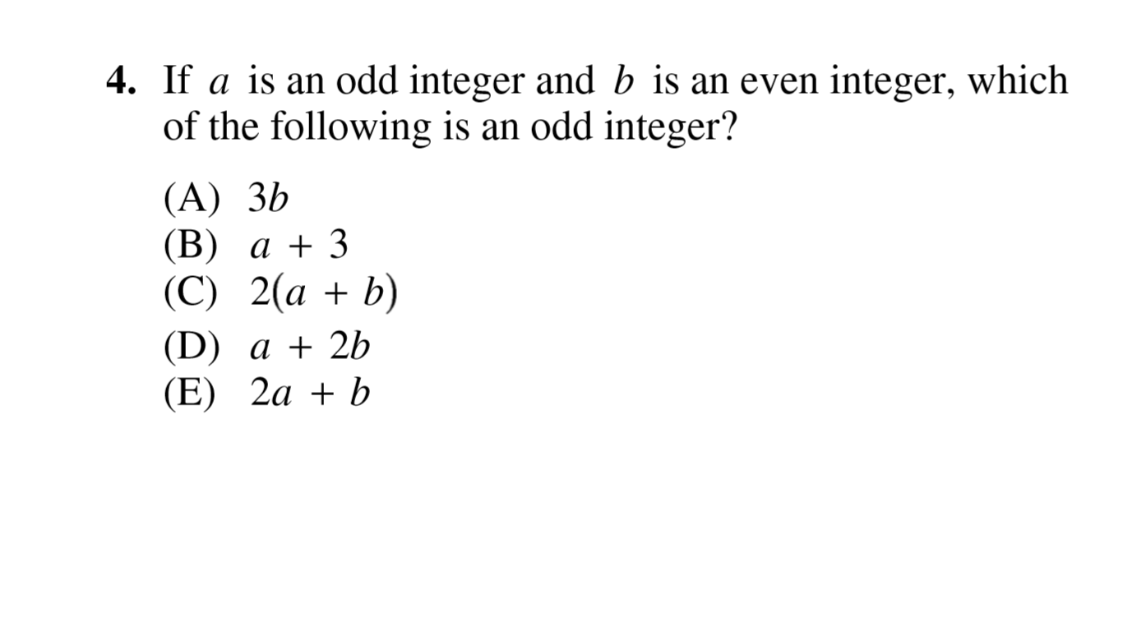
Plugging in Numbers

Slide 24
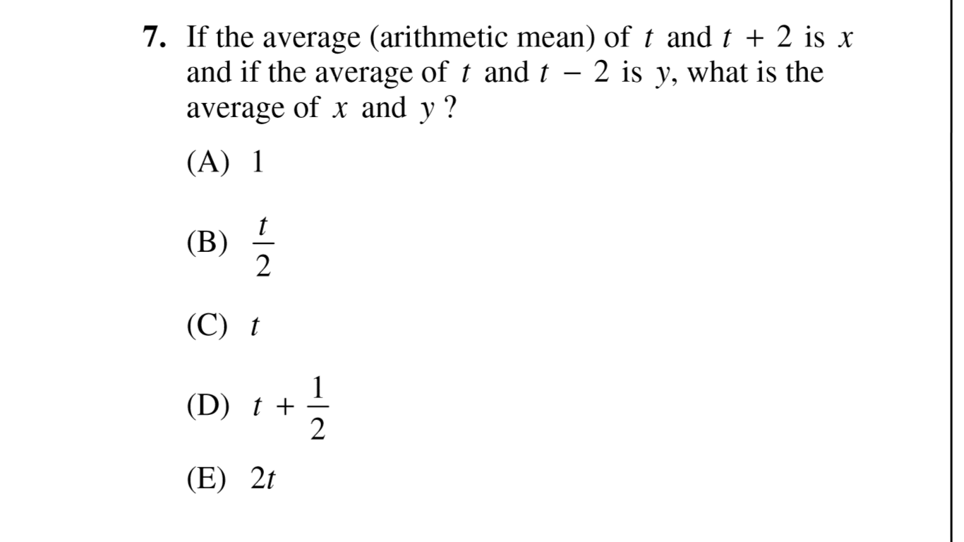
Plugging in Numbers

Slide 25
Critical Reading
Timing is CRUCIAL
ACT: Finish each passage (10 questions) in 8.5 minutes.
To Read or not to Read

Slide 26
Critical Reading
[ACT] If timing is tricky for you, and it probably will be, don’t do the questions in order. Start with:
  The questions with line numbers (“In lines 15-18, the author most nearly means…”), THEN
  The questions that mention a specific paragraph (“What is the author’s intent in the third paragraph?”), THEN
  The questions that give you something specific to search for and read. (“The author’s reason for introducing the Hadron Collider into his argument is to…”), THEN
  Only lastly will you answer the general questions. (“What is the author’s primary purpose”?)

Slide 27
General Critical Reading Rules
1. Come up with your own answer first
2. Plot summary, not analysis
3. 4 lines rule
4. Avoid strong wording / favor the wishy-washy

Slide 28
For Example
At one time, he had entertained serious doubts about wives being given the right to share equally with their husbands the disposition of property, since “the husband labors hard” while the wife might not be earning money. But his discussions with pioneers of the women’s rights movement convinced him that even though wives were not paid for their domestic labors, their work was as important to the family as that of their husbands.
Question: The discussion of Douglass’ position on property rights for women suggests that Douglass
A) was extremely adept at political negotiation
B) was flexible enough to change his views
C) sided with women’s rights leaders on this issue so that they would support him on abolition
D) believed that causes should be tackled one at a time
E) believed that state laws could be easily changed

Slide 29
For Example
At one time, he had entertained serious doubts about wives being given the right to share equally with their husbands the disposition of property, since “the husband labors hard” while the wife might not be earning money. But his discussions with pioneers of the women’s rights movement convinced him that even though wives were not paid for their domestic labors, their work was as important to the family as that of their husbands.
Question: The discussion of Douglass’ position on property rights for women suggests that Douglass
A) was extremely adept at political negotiation
B) was flexible enough to change his views
C) sided with women’s rights leaders on this issue so that they would support him on abolition
D) believed that causes should be tackled one at a time
E) believed that state laws could be easily changed

Slide 30
Words to Favor
Suggest
Particular
Certain
Might
Could
Possibly
Seems
Apparently

Slide 31
Words to Avoid
Never
Always
Must
Only
Strictly
Also:
  Two-word combinations that intensify each other
    (“harshly condemning” “genially tolerant”)
  Critiques of authors

Slide 32
(ACT only): Science
35 minutes for 7 passages. 5 minutes each.
  Timing if CRUCIAL
To read or not to read
Last question of each passage requires one more step of reasoning.
Consider saving “Scientist 1 vs Scientist 2” passage to the end.

Slide 33

SAT Subject Tests: RIP
Math
Literature
Foreign Language
Science
History

Slide 34
Essay
40 minutes of speed writing. Signifiers, not content.
    Length
    Punctuation
    Structure

Slide 35
Essay
Consider for the ACT essay:
  ACT paragraphs:
    Intro
      Flatter the premise in the intro.
    Thesis
    Antithesis
      “Some might argue, however, that…”
    Synthesis
    Conclusion

Slide 36
Source of Practice Materials
http://www.eliotschrefer.com/sat-act-materials
Includes:
  A tipsheet with general strategies summary (geared toward ACT)
  this powerpoint from today’s session
  4 practice ACTs in pdf form
  4 practice SATs in pdf form (go to Bluebook and Khan Academy for digital prep)

